Slide 1
Business Process Modelling

Slide 2
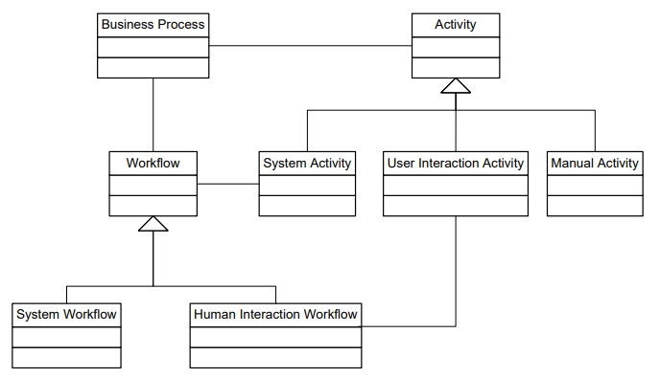
Business process Conceptual Model

Slide 3
Abstraction Concepts
A traditional abstraction concept in computer science is the separation of modelling levels.
from instance level to model level to meta model level.
Horizontal Abstraction:
The meta model level, the model level, and the instance level play important roles in the design and analysis of complex systems in general and software systems in particular.

Slide 4
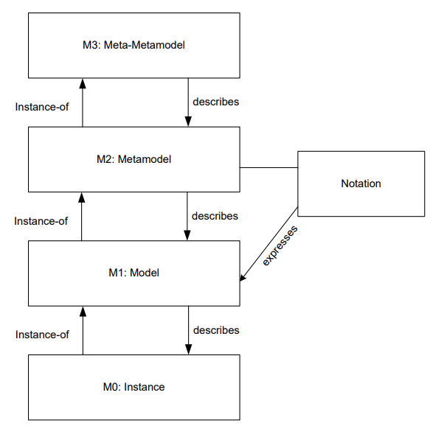
Levels of abstraction
The instance level reflects the concrete entities that are involved in business processes. Executed activities, concrete data values, and resources and persons are represented at the instance level.

Slide 5
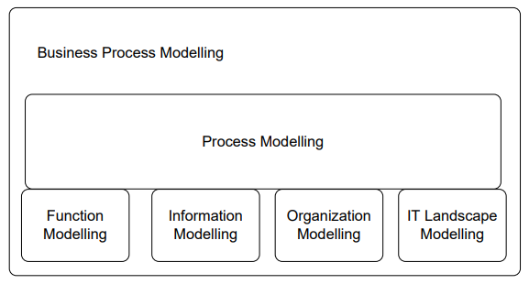
Levels of abstraction
Vertical Abstraction: distinct modelling subdomains are identified
Process modelling is at the center of the modelling effort.
It also integrates the modelling efforts that are conducted in the other subdomains.

Slide 6
The functional model investigates the units of work that are being enacted in the context of business processes.
from coarse-grained business functions to finegranular functions at the operational level that are realized by knowledge workers and information systems.
The specification of these functions can be informal, using English text or formal
more precise specifications are required in the software layer when it comes to implementation.

Slide 7
Information Modeling:
The investigation and proper representation of data in business processes is important,
Decisions made during a business process depend on particular data values.
Also data dependencies between activities need to be taken into account in process design,
Avoid situations in which a function requires certain data not available at that time

Slide 8
The proper representation of the organizational structure (Organizational Modelling) of a company is an important requirement. Activities in the business process can then be associated with particular roles or departments in the organization.
The operational information technology landscape, i.e., the information systems, their relationships, and their programming interfaces, needs to be represented to use the functionality provided by the information systems

Slide 9
From Business Functions to Business Processes
value chains provide a high-level organization of the functions that an enterprise performs
To provide a more detailed view, these top-level business functions are broken down to functions of smaller granularity.
and, ultimately, to activities of operational business processes.
Functional decomposition is the technique of choice

Slide 10
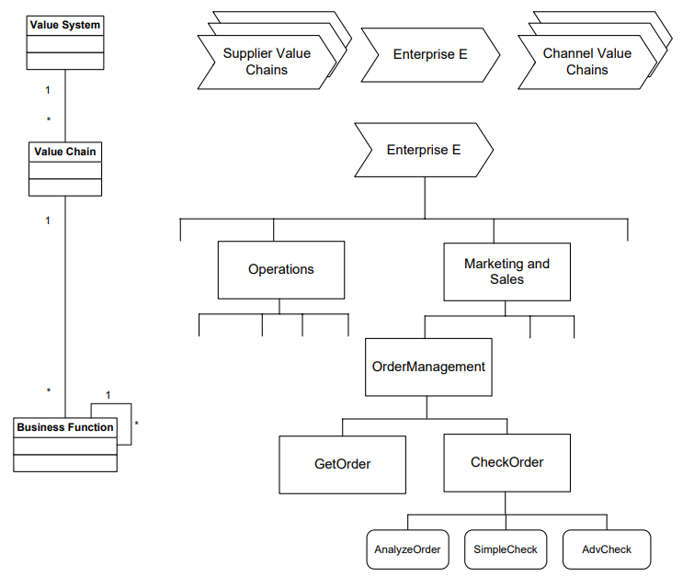
business functions are represented by rectangles

Slide 11
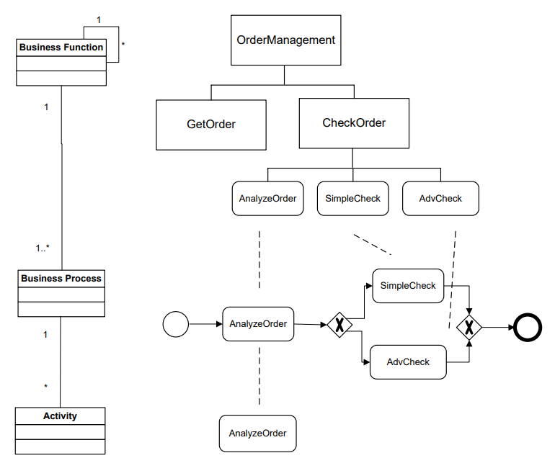
Fine-grained business functions
Business functions of small granularity are organized as a business process

Slide 12
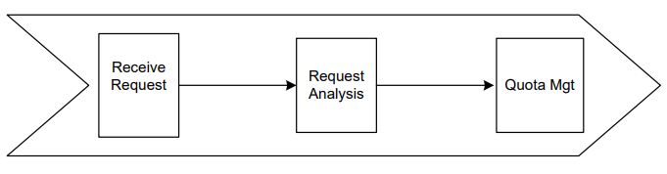
Related business processes, high-level view
The Receive Request business function is realized by the business process shown:

Slide 13
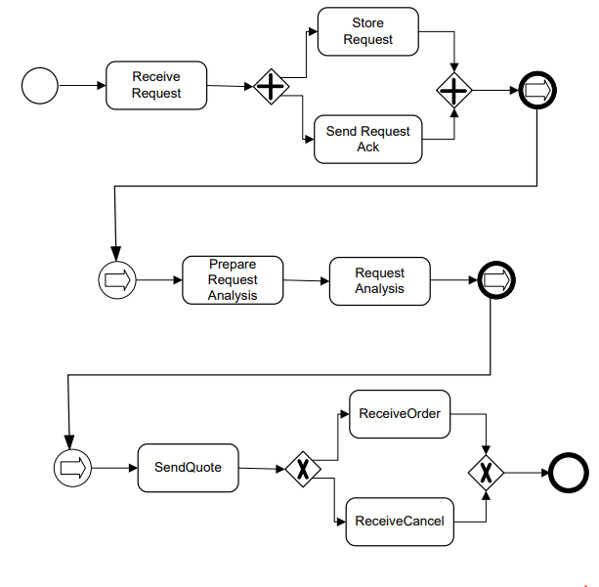
Related business processes, detailed view
Coarse-grained business functions that are decomposed into smaller-grained business functions,
“A functional decomposition of coarse-grained business functions to fine-granular activities defines the functional perspective of a business process.”

Slide 14
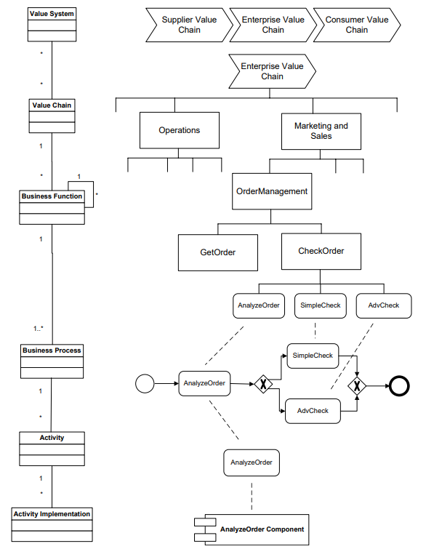
Levels of business process management.
From value systems to activity implementations

Slide 15
Activity Models and Activity Instances
Business functions provide a high-level, coarse-grained representation of the work conducted by enterprises.
Activities can be found in the leaves of the functional decomposition.
Activity instances have to be characterized.

Slide 16
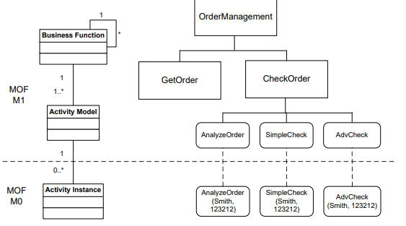
Relationships between business functions, activity models, and activity instances.
Activity models represent the M1 layer of the Meta Object Facility
Activity instance layer corresponds to M0.

Slide 17
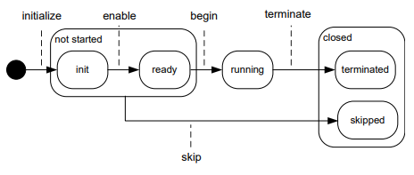
State transition diagram
Each activity instance during its lifetime is in different states.
These states and the respective state transitions can be represented by a state transition diagram.

Slide 18
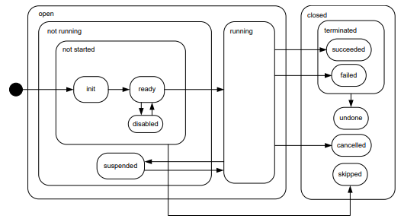
State transition diagram for activity instances, detailed version

Slide 19
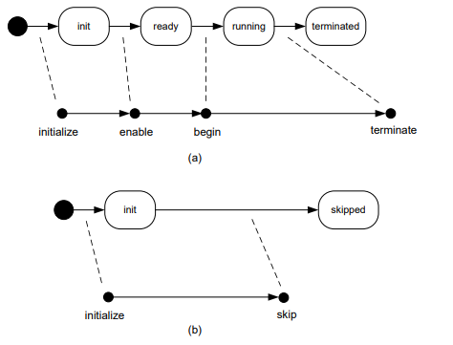

Slide 20
Process Models and Process Instances
Process Model: a set of process instances with a similar structure.
Edge: Relationships between nodes in a process model.
Node: A node in a process model can represent an activity model, an event model, or a gateway model.

Slide 21
Activity Models: Activity models describe units of work conducted in a business process. Each activity model can appear at most once in a process model. No activity model can appear in multiple process models. It has exactly one incoming edge and exactly one outgoing edge.
Event models: Event models capture the occurrence of states relevant for a business process. Process instances start and end with events.
Gateway Models: Gateways are used to express control flow constructs, including sequences, as well as split and join nodes.

Slide 22
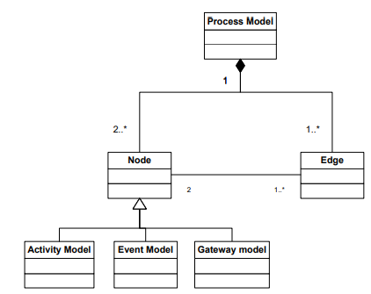

Slide 23
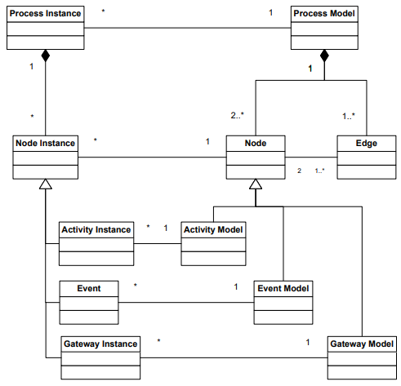

Slide 24
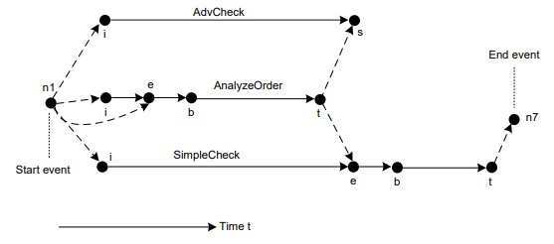

Slide 25
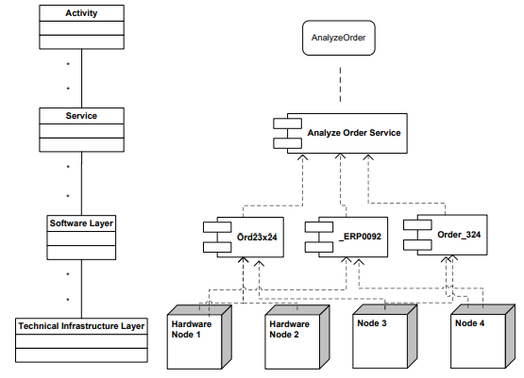
Service-enabling infrastructure and business processes

Slide 26
Process Orchestrations

Slide 27
Control-Flow Patterns
1. Sequence 2. Parallel Split 3. Synchronization 4. Exclusive Choice 5. Simple Merge

Slide 28
Pattern 1 (Sequence)
A task in a process in enabled after the completion of a preceding task in the same process.
Synonyms
Sequential routing, serial routing.
Examples
The verify-account task executes after the credit card details have been captured.
A receipt is printed after the train ticket is issued.

Slide 29

Motivation
The Sequence pattern serves as the fundamental building block for processes.
It is used to construct a series of consecutive tasks which execute in turn one after the other.
Two tasks form part of a Sequence if there is a control-flow edge from one of them to the next which has no guards or conditions associated with it.
Context
An instance of the Sequence pattern cannot be started again until it has completed execution of the preceding thread of control

Slide 30
Pattern 2 (Parallel Split)
The divergence of a branch into two or more parallel branches each of which execute concurrently.
Synonyms: AND-split, parallel routing, parallel split, fork.
Examples
After completion of the capture enrolment task, run the create student profile and issue enrolment confirmation tasks simultaneously.
Once the customer has paid for the goods, pack them and issue a receipt.

Slide 31
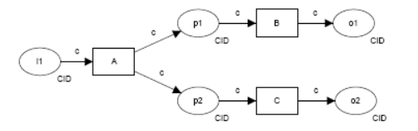
Motivation
The Parallel Split pattern allows a single thread of execution to be split into two or more branches which can execute tasks concurrently.
These branches may or may not be re-synchronized at some future time.

Slide 32
Pattern 3 (Synchronization)
The convergence of two or more branches into a single subsequent branch such that the thread of control is passed to the subsequent branch when all input branches have been enabled.
Synonyms: AND-join, rendezvous, synchronizer.
Examples
The despatch-goods task runs immediately after both the check-invoice and produce-invoice tasks are completed.
Cash-drawer reconciliation can only occur when the store has been closed and the credit card summary has been printed.

Slide 33
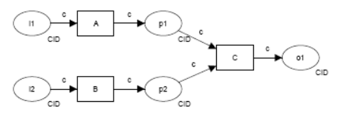
Motivation
Synchronization provides a means of reconverging the execution threads of two or more parallel branches.

Slide 34
Pattern 4 (Exclusive Choice)
The divergence of a branch into two or more branches
such that when the incoming branch is enabled,
the thread of control is immediately passed to precisely one of the outgoing branches
based on a mechanism that can select one of the outgoing branches.
Synonyms: XOR-split, exclusive OR-split, conditional routing, switch, decision, case statement.

